Slide 1
Hottest Genre’s On Steam
by Chamyia Williams and Joshua Parker

Slide 2
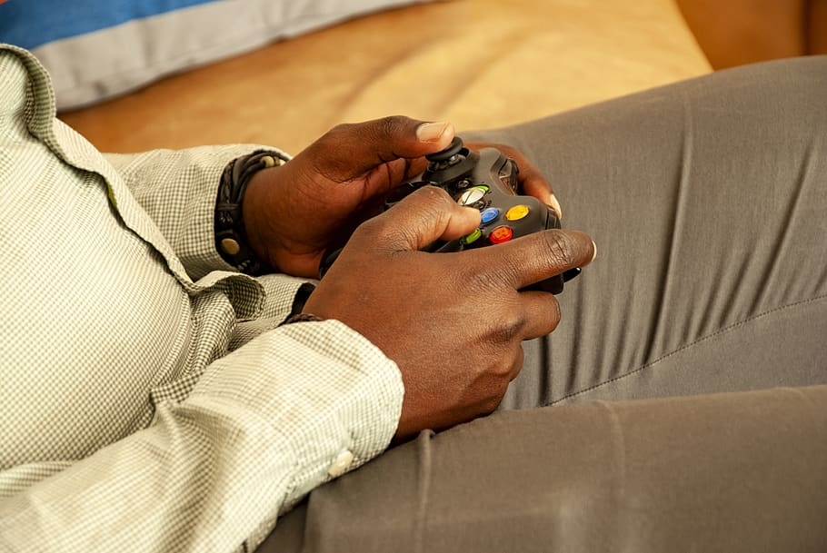
Video Games are Hot!
Now more than ever there has been a boom in the amount of people interested in video games. From Twitch streamers, to YouTubers, to even Facebook live streamers the video game industry has gained new traction.

Slide 3


1. Given the data
Answer these questions
Which game has the most playtime?
Which genre has the most playtime?
Can we create a recommender system based on the information?
What is the difference in playtime between action, sports, and shooter games

Slide 4
Which game has the most playtime?
Outside insight
The rise of video game content creator has had a huge influence on these trends.

Slide 5
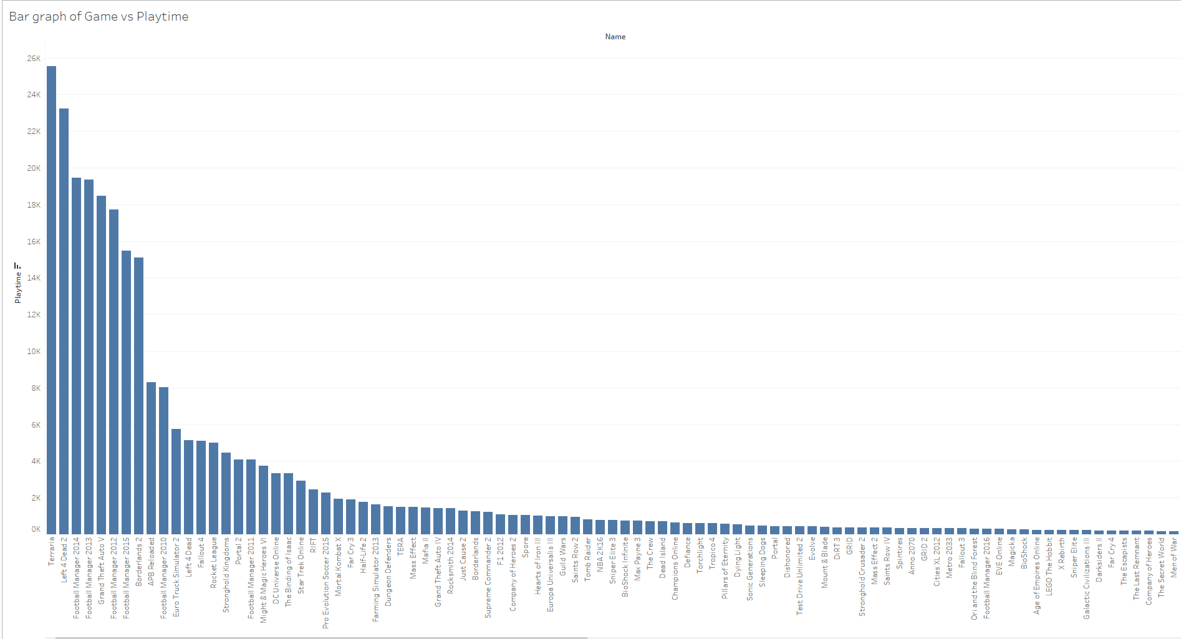

Slide 6
What a game! What is Terraria?
Blending elements of classic action games with the freedom of sandbox-style creativity, Terraria is a unique gaming experience where both the journey and the destination are completely in the player’s control. The Terraria adventure is truly as unique as the players themselves!
Outside Insight
Right behind Terraria are two games outside of its genre. Left for dead 2 and football manager 2014. These two are shooter and sports games respectively.

Slide 7

What genre has the MOST PLAYTIME of video games?
Outside Insight
In recent years, with the rise of P.C gaming, more and more gamers are turning to P.C to play video games. In Fact most newly released video games also come out on P.C.

Slide 8
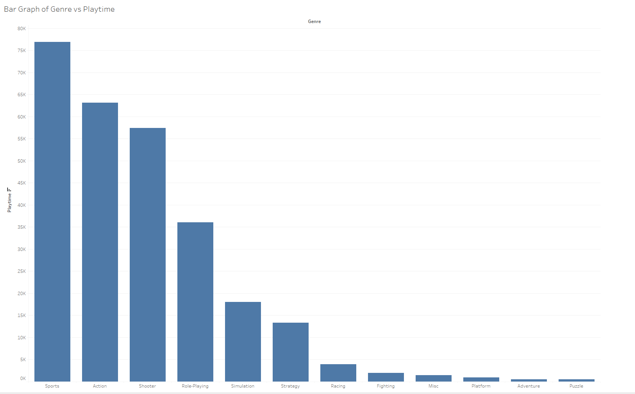

Slide 9
Wow!
Sports has a huge lead on most played genre!
Things to note! Many sports games are multiplayer or competitive. This means it is more likely to have more people playing at the same time together which increases playtime.
Sports facts! It is not surprising sports is the most playtime. Many people who do not consider themselves gamers play this genre. This genre of player is also the most loyal to the genre. In other words you will most likely not see a sports player playing any other genre.

Slide 10

Can we create a recommender system based on the information?
Tip
Many gamers do not just play one game. To increase sales and understand the likelihood of gamer playing a new game video game companies might want to rely on recommender systems

Slide 11
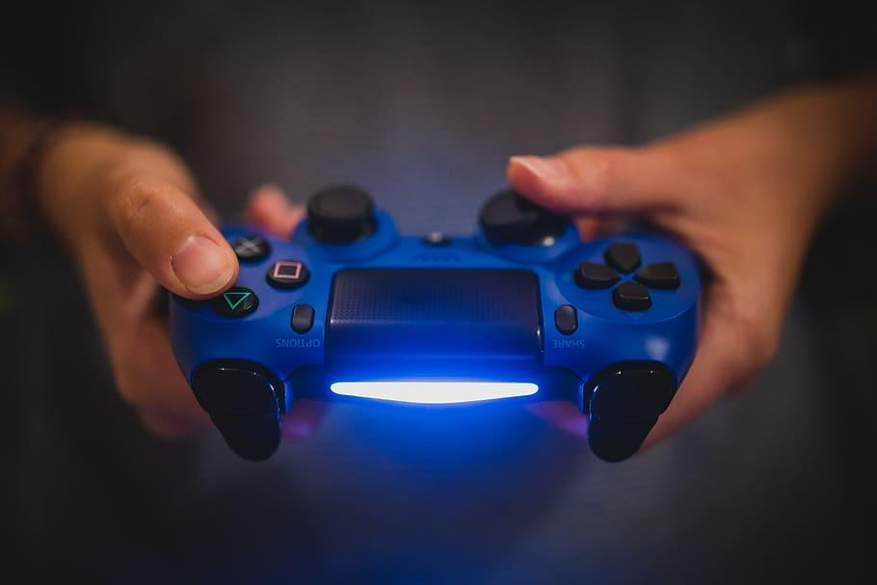
Recommender system
Can we build one? Yes
Results
When enough data is present, different games are recommended as intended
Issues
Not enough user data to give ratings
No errors, but after much debugging, there is a noticeable lack of data for each user to bridge the gap for predicting a possible rating.
Outside Insight
Many gamers argue over which platform is better, Xbox or Playstation. I grew up on both but playstation has always had more options.

Slide 12
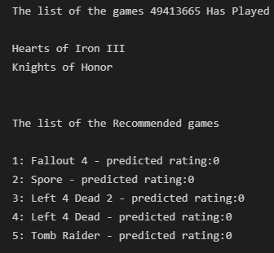
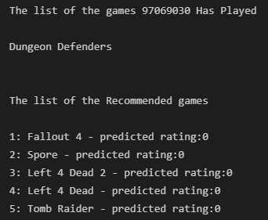
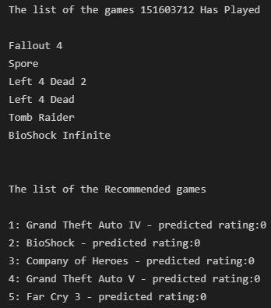

Slide 13

What is the difference in playtime between action, sports, and shooter games
Outside Insights
These three are the top playtime overall in our data

Slide 14
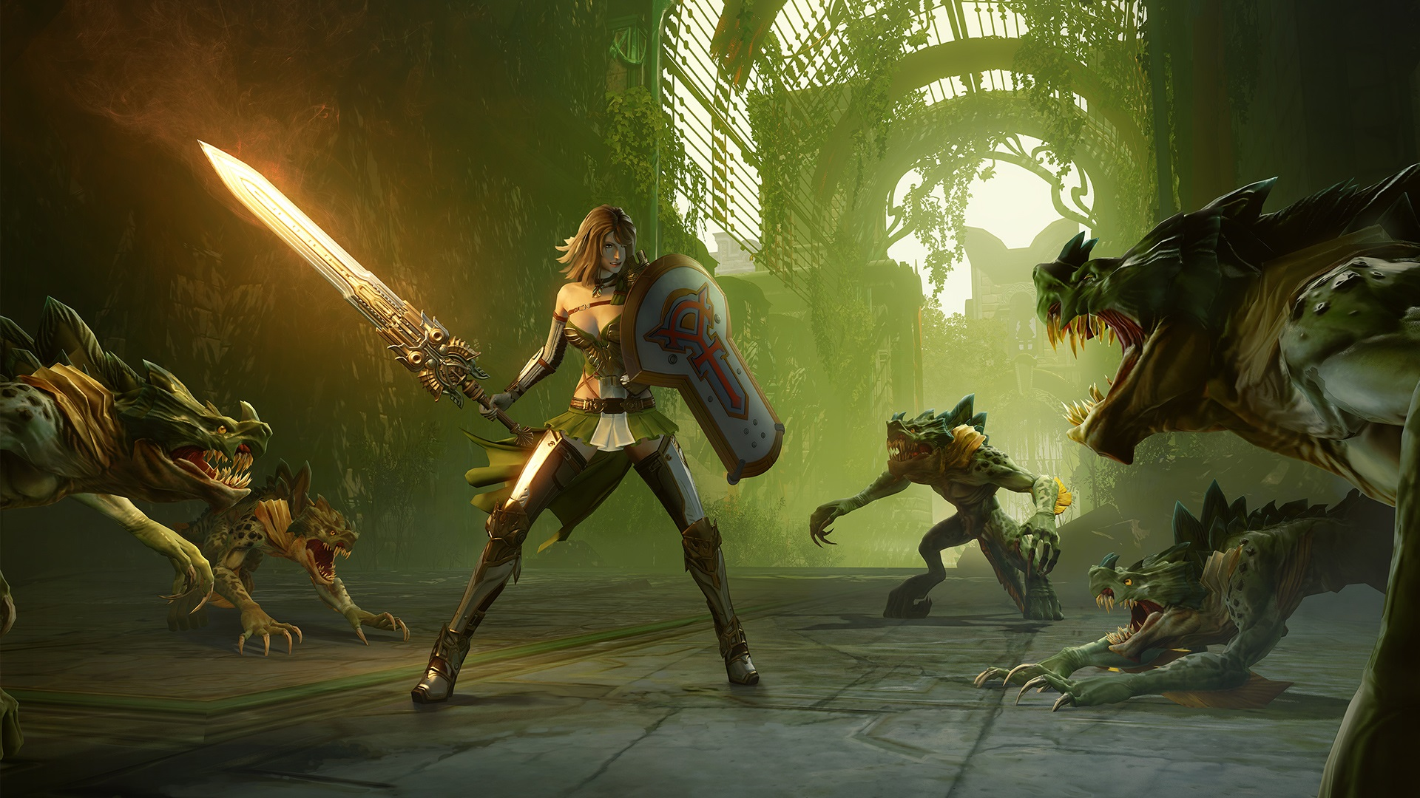
One way anova test
Our data shows using the mean of each Genre in this subset of data, Sports has the highest playtime at 250.37 hours, followed by Action at 31.32 hours then finally Shooter at 26.54 hours.

Slide 15
Playtime vs sports games

Slide 16
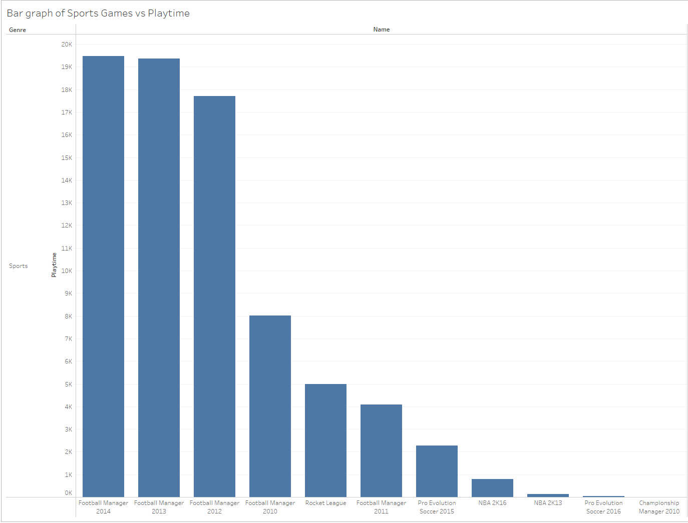

Slide 17
Playtime vs action games

Slide 18
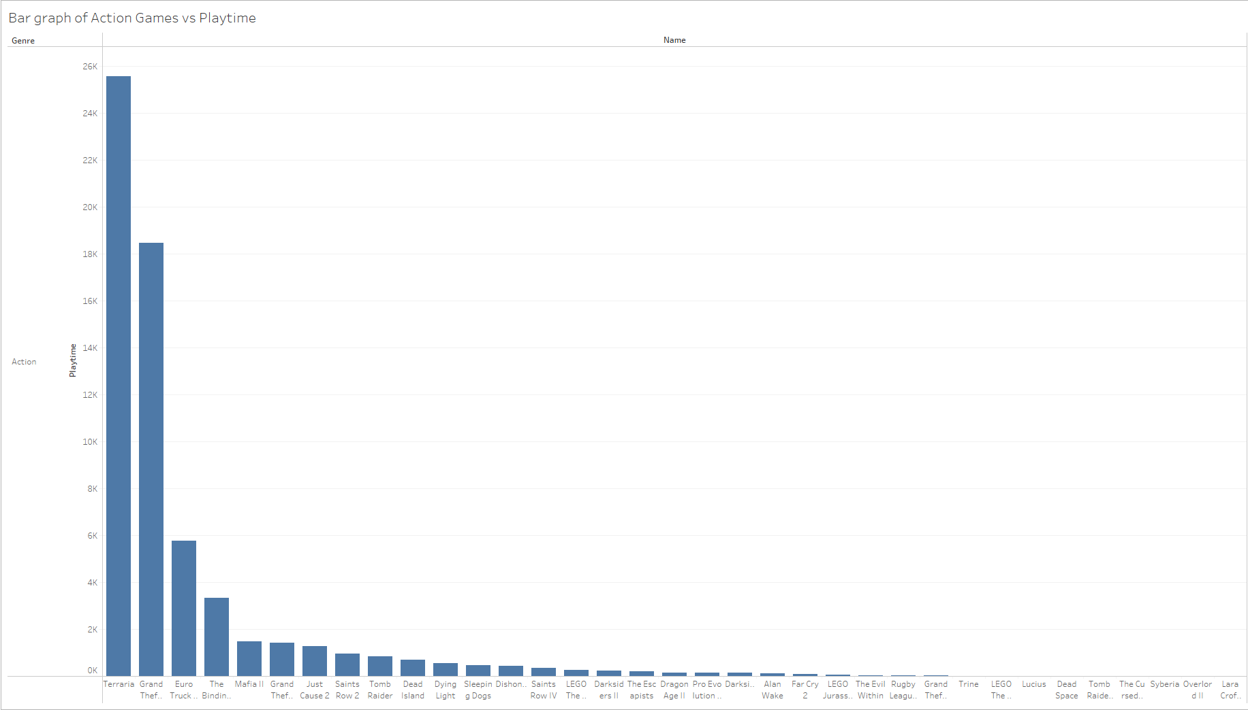
Playtime vs action games

Slide 19
Playtime vs Shooter games

Slide 20
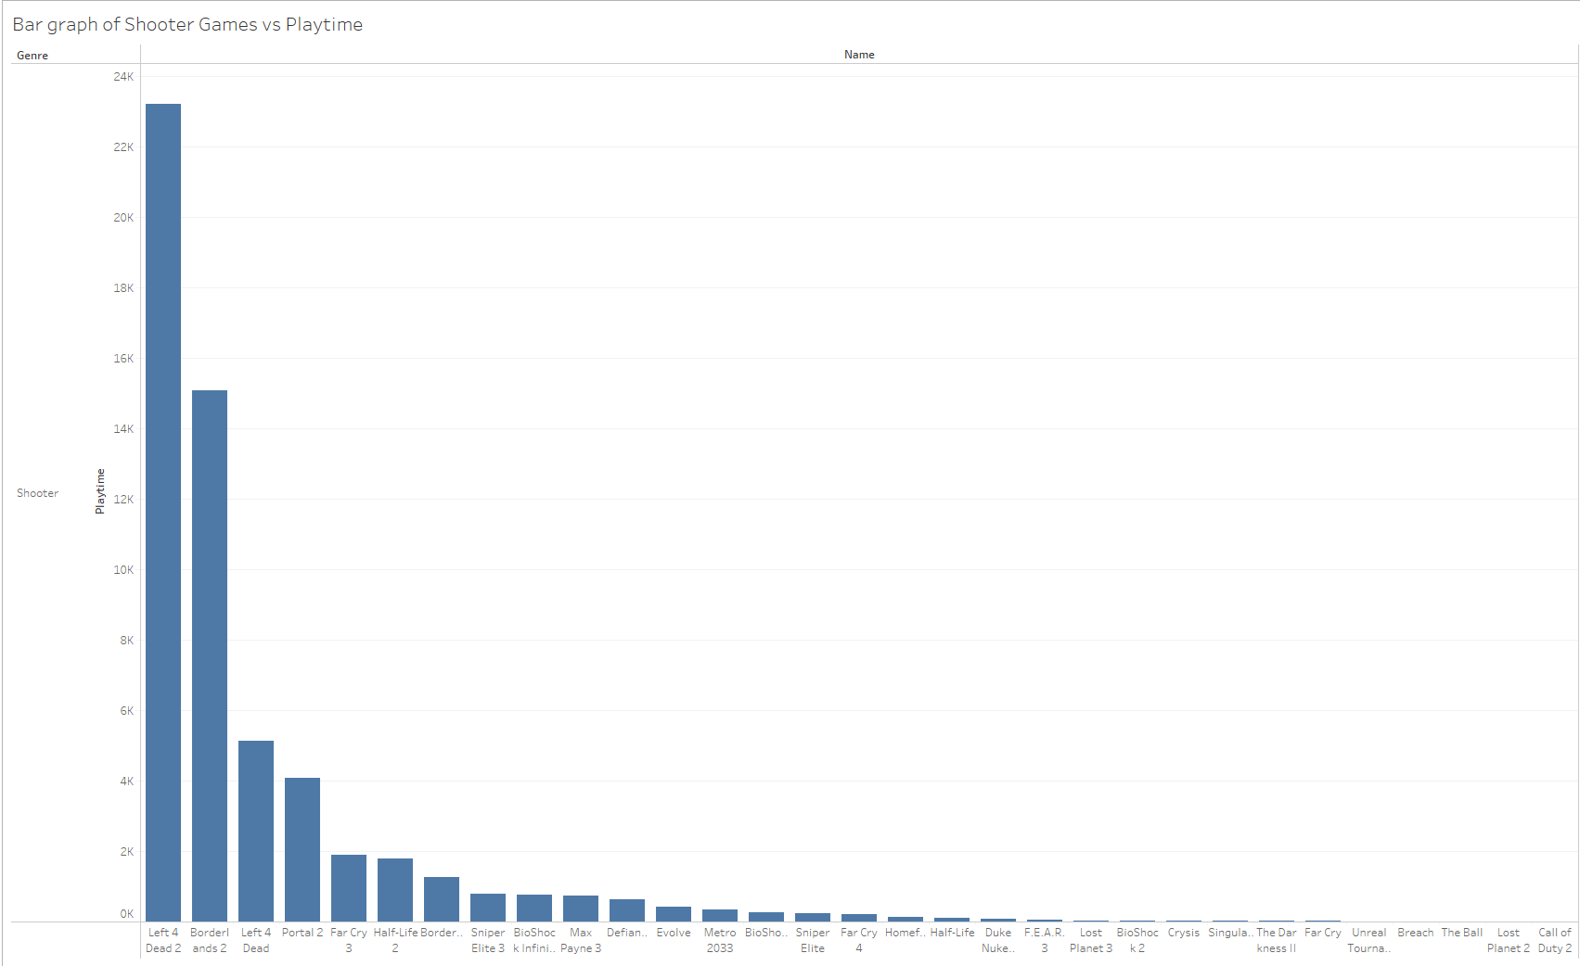

Slide 21
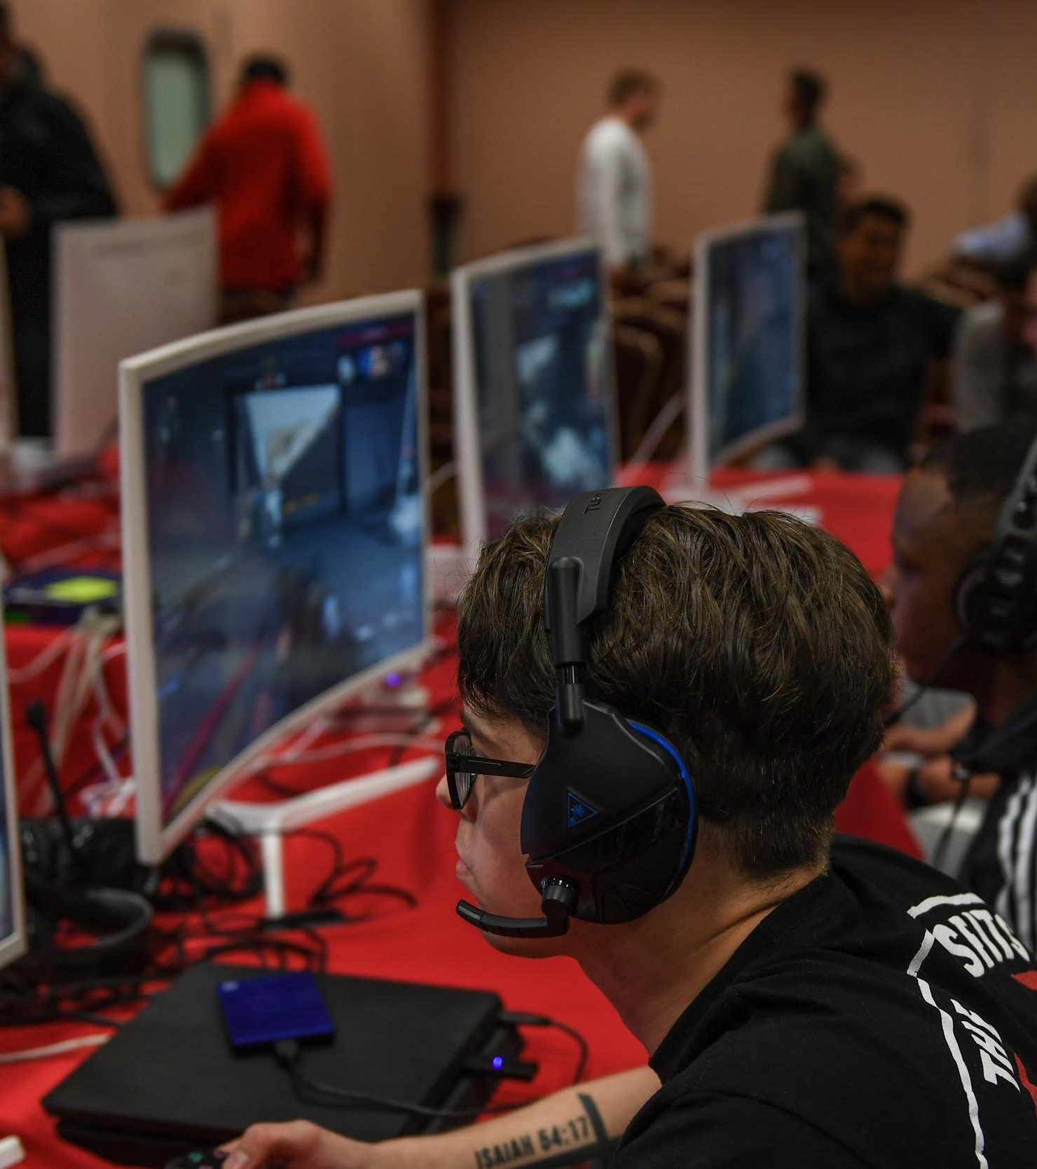
Gaming Today
Many of these trends shape the gaming of the future. One being that multiplayer or co-op games have the most playtime.
With more immersive deep storytelling, new and exciting technology, and an ever growing gaming community the sky's the limit.
By Chamyia Williams and Joshua Parker
Thank you for watching!

